Slide 1


Slide 2


Slide 3
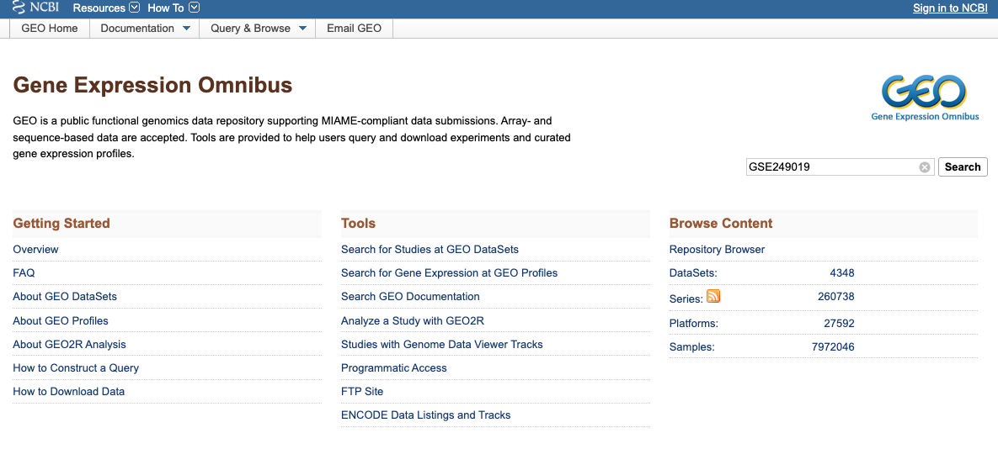
Gene Expression Omnibus (GEO)

Slide 4
 | GEO (Gene Expression Omnibus) | SRA (Sequence Read Archive)
Purpose | Curated repository for processed genomics data (expression matrices, counts, metadata) | Archive for raw high-throughput sequencing data (FASTQ/BAM/CRAM)
Data Type | Analyzed/processed data (expression profiles, normalized counts, differential results) | Raw sequencing reads from next-generation sequencing platforms
Formats | TXT, CSV (and other processed count matrices) | FASTQ, SRA binary format
Use Case | Quick access to ready-to-use gene expression or array data for downstream analysis | Access to original raw sequencing files for custom processing (alignment, quantification, etc.)
Metadata | Rich experiment-level annotation (study design, platforms, sample info) | Technical metadata about sequencing runs, instruments, library prep
Relationship | Often provides links to corresponding SRA accessions if raw data exists | Frequently cross-linked back to GEO for processed/curated results

Slide 5
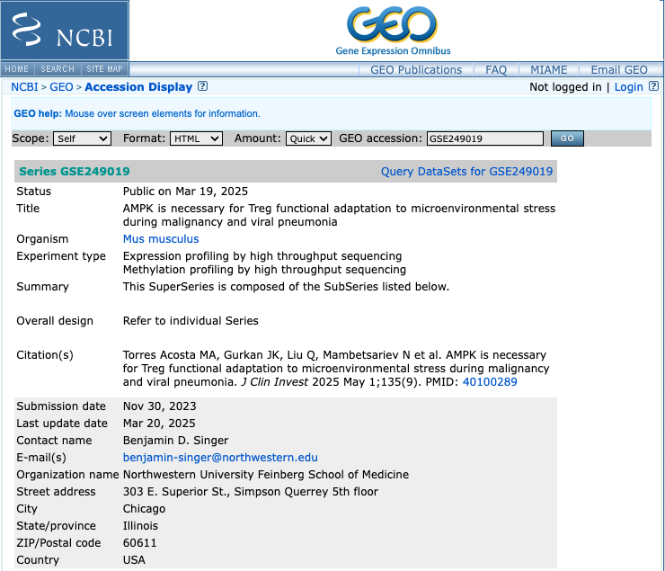
Find published data on GEO (GSE249019)

Slide 6
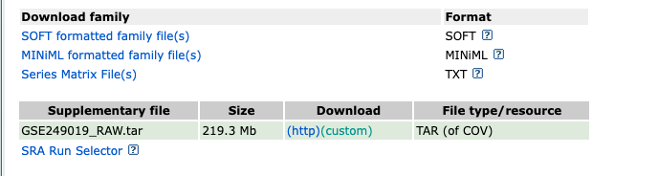
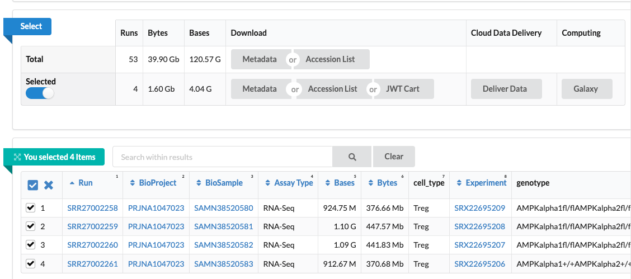

Slide 7
Set up
log onto Quest
ssh <netid>@login.quest.northwestern.edu # enter your netid password
Move to our classroom folder
cd /projects/e32680
Make your own subfolder if you don’t have one
mkdir <folder name>
cd ./<folder name> #navigate to your folder

Slide 8
Download fastq files with screen+srun
screen
srun -N 1 -n 1 --account=e32680 --mem=5G --partition=short --time=01:00:00 --pty bash -l
chmod +x get_fastq.sh
./get_fastq.sh

Slide 9
Download fastq files with array jobs
module load sratoolkit/3.0.0
fasterq-dump <SampleAccessionNumber>\
--split-files \
--threads 3 \
--outdir <YourFolder> \
--progress

Slide 10
Retrieve project meta data in R

Slide 11
GEO exercise: download some data of your choice!
Notes:
https://www.ncbi.nlm.nih.gov/ (main search portal)

Slide 12
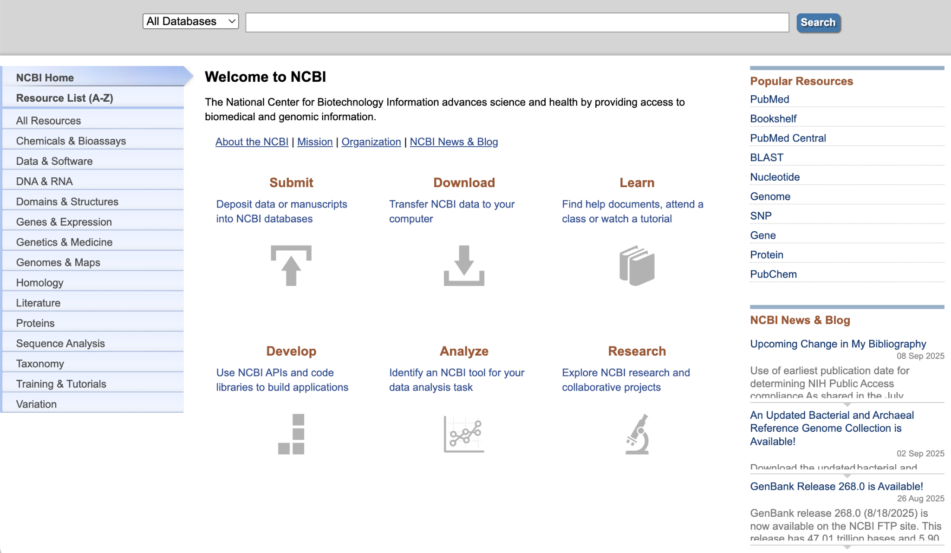
NCBI Search

Slide 13
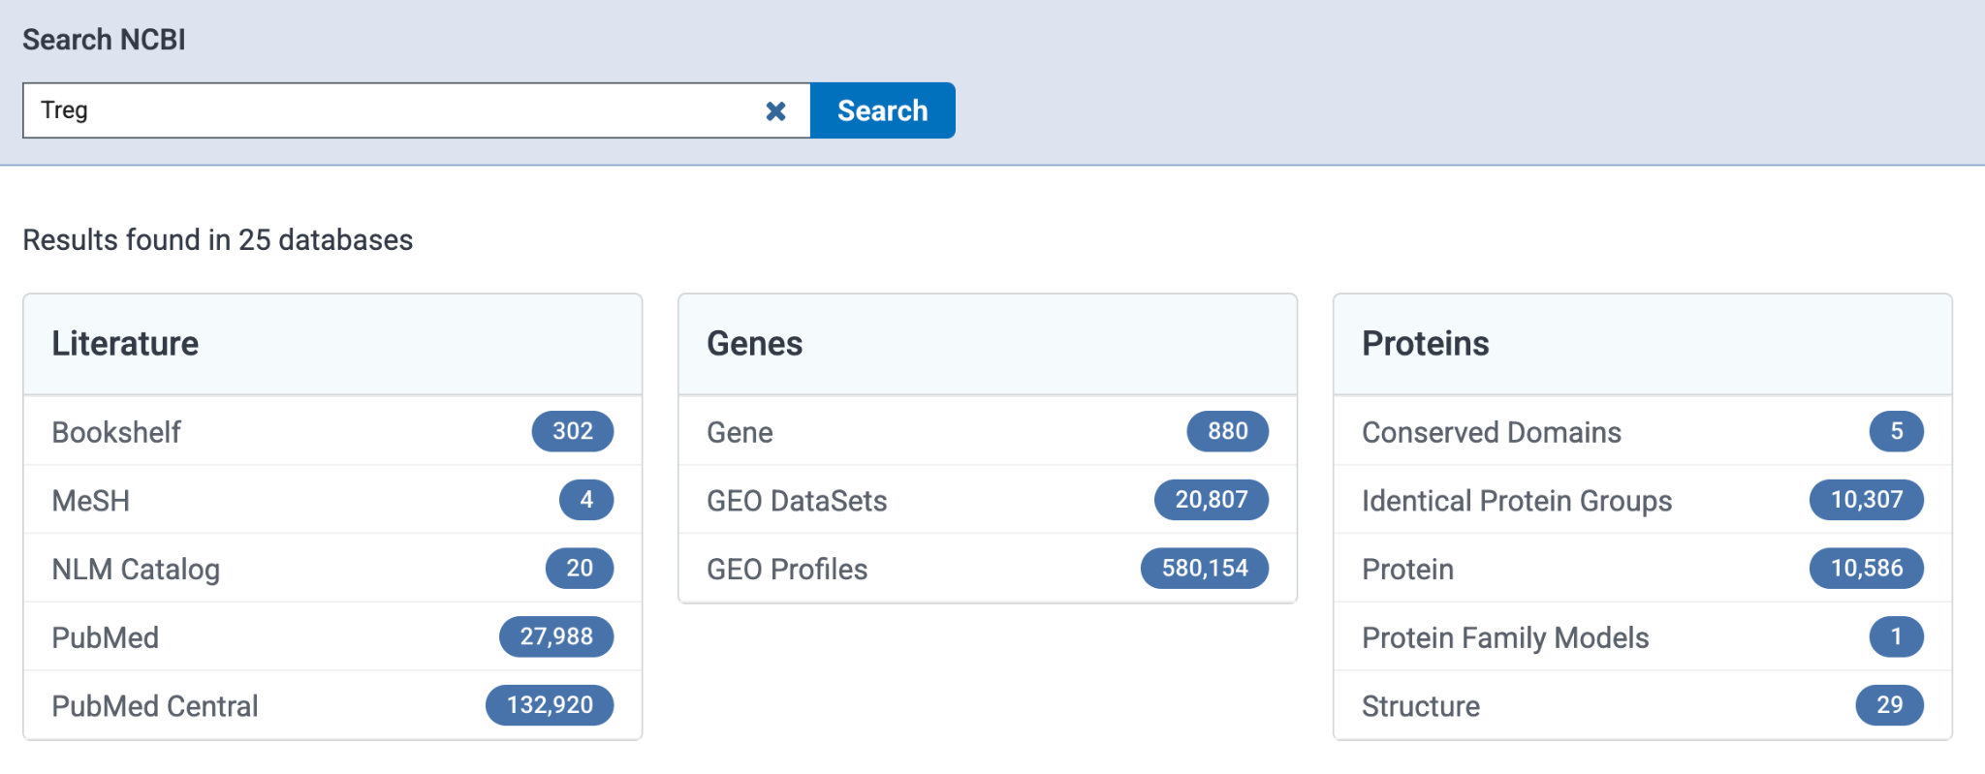
NCBI: Search for Sequencing Data

Slide 14
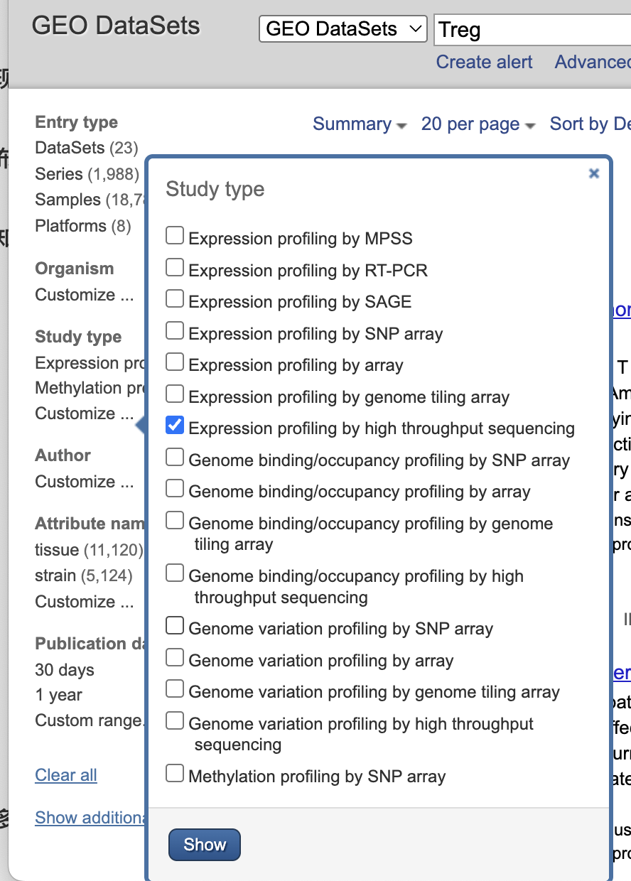
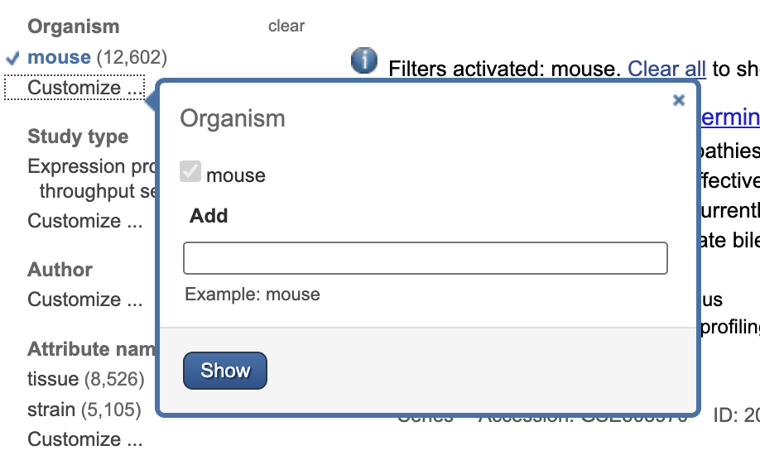
NCBI Search Filter

Slide 15
More fasterq-dump examples
module load sratoolkit/3.0.0
#minimum command
fasterq-dump SRR27002259
#download single sample with 5 threads
fasterq-dump SRR27002259 -O ./fastq_files --threads 5
#set temporary folder for downloading
fasterq-dump SRR27002259 -O ./fastq_files -t ./fastq_temp

